Slide 1
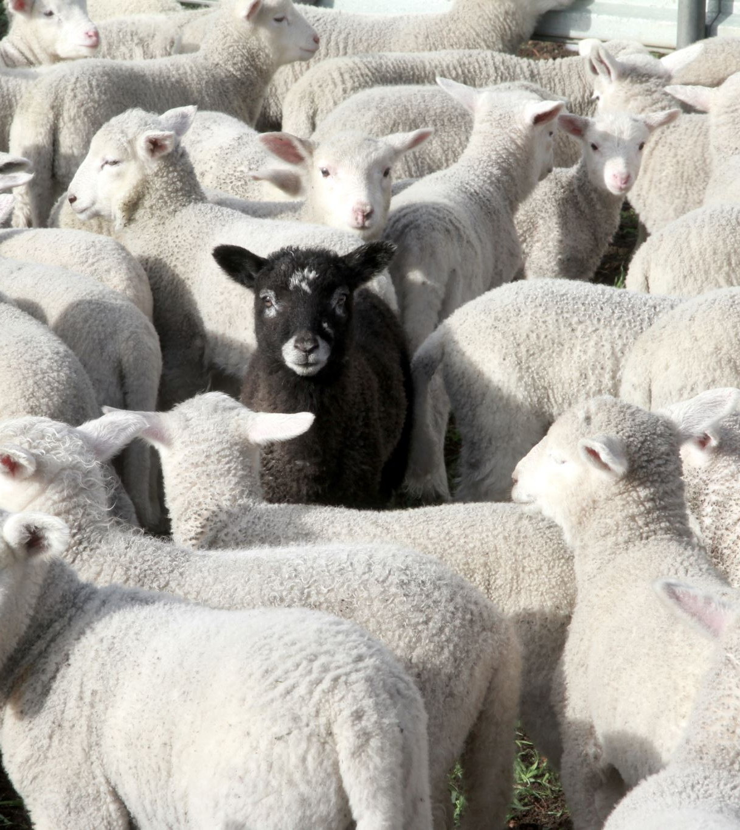
Flockenomics
Group 6
Andrew
Catherine
Amanda
Jack
Garry
Elliot
Team lead: Roopika

Slide 2
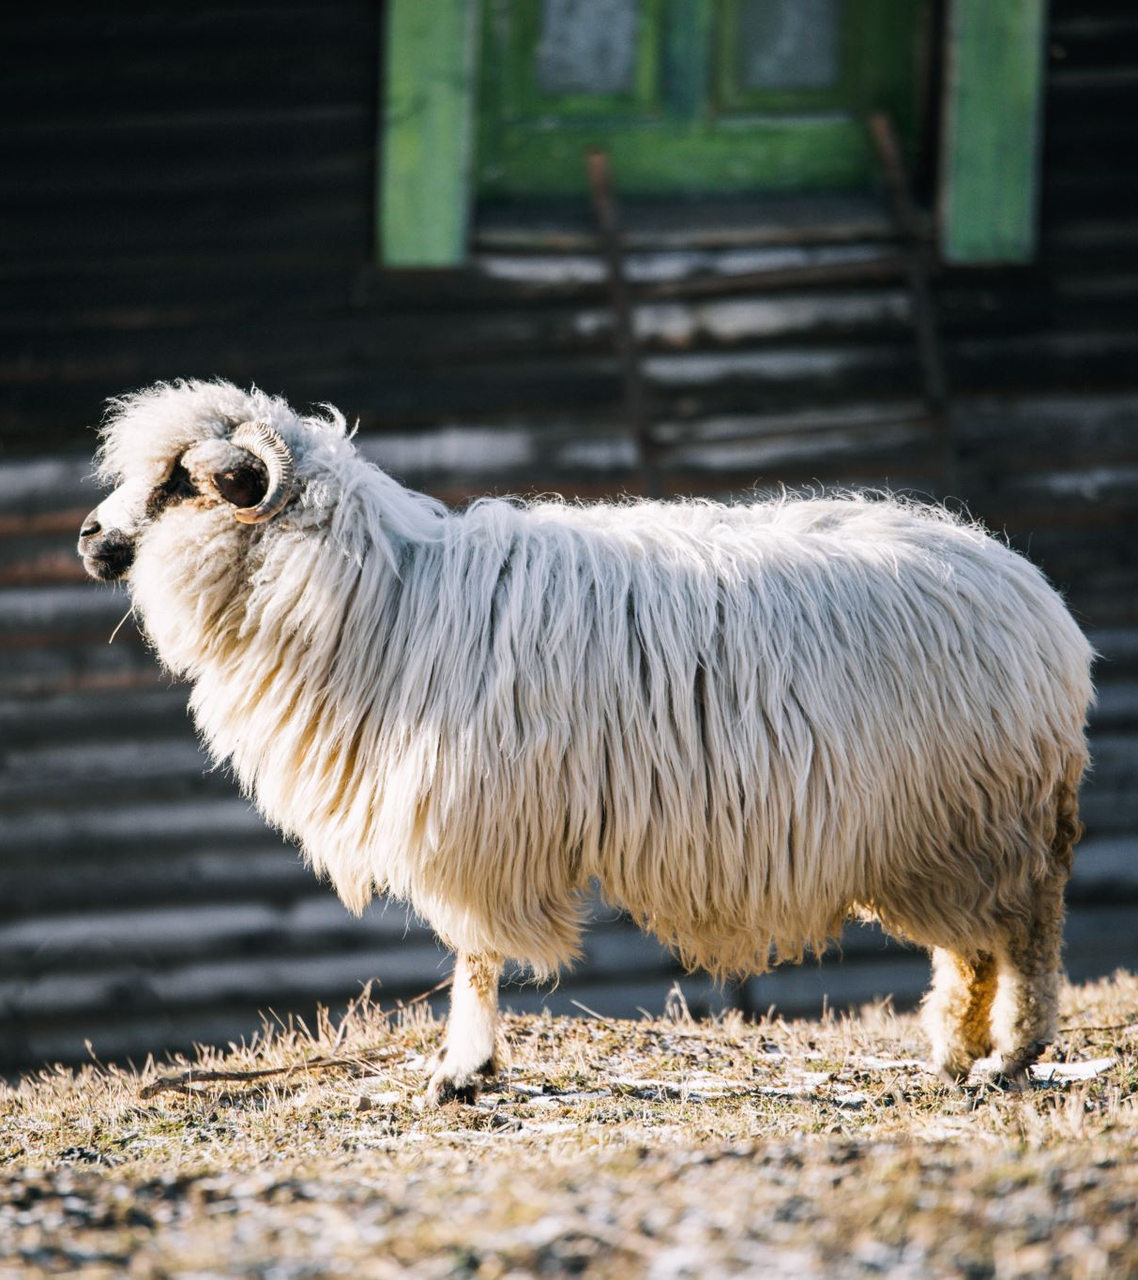
Introduction
Ethical Analysis
Who did we talk to?
Sheep farmers
Dog trainer and technologists
Animal behaviourist
What did it show?
What’s this going to cost?
Economic Analysis
Conclusion
Questions

Slide 3

Ethical Analysis

Slide 4

Lack of guidelines
There are no UK guidelines for robots working with animals
What are the welfare issues - for all concerned?
Here, we attempt to identify some of the human, economic & social factors…

Slide 5
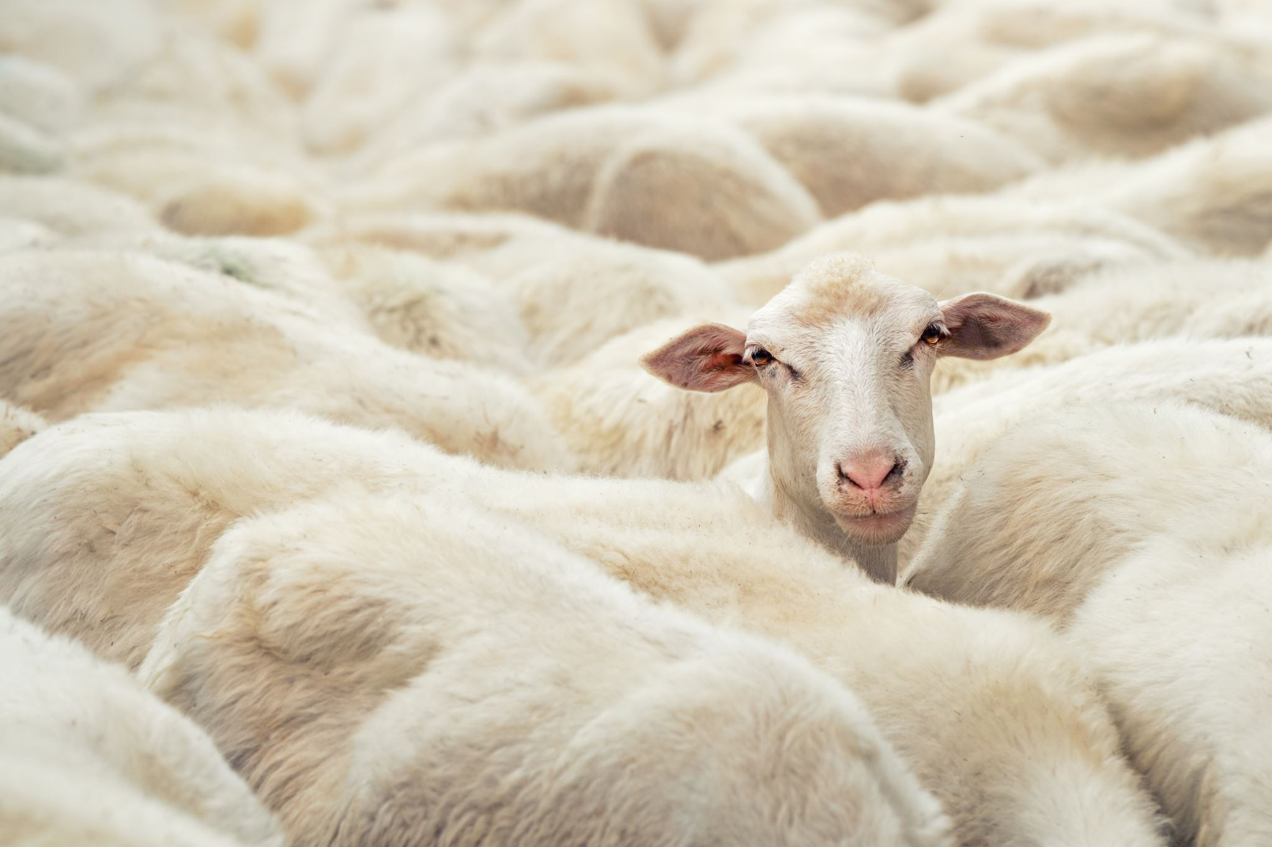
General Animal Welfare Guidelines
Welfare of Farmed Animals (England) Regulations 2007, implementing EU Directive 98/58/EC, which mandates that animals be free from unnecessary pain, suffering, and distress. It emphasizes that “the freedom of animals to express normal behaviour”
The Five Freedoms framework (FAWC, 1992) remains a key ethical reference:
Freedom from hunger and thirst
Freedom from discomfort
Freedom from pain, injury, or disease
Freedom to express normal behaviour
Freedom from fear and distress

Slide 6
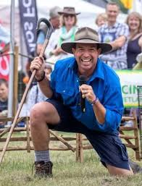
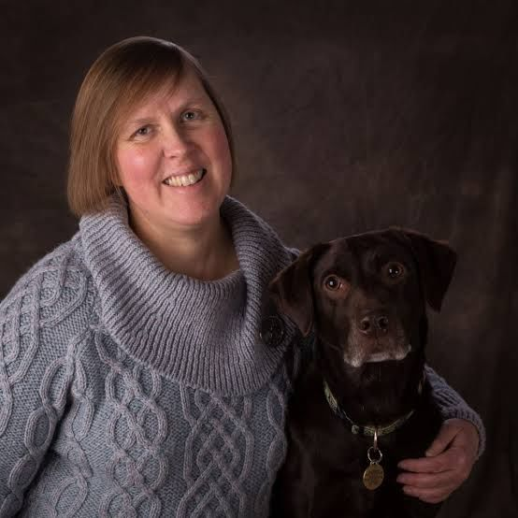
Stakeholder Overviews
Managing
A second-year university student studying Animal Behaviour and Management. Works at White Post Farm, with experience observing sheep but not in formal herding.
John Breare
Owns a flock of ～70 sheeps
Has experience with automatic system in diary factory
James Crowder
Over 50 years of hands-on experience in sheep and cattle farming. Operates a mid-sized livestock farm — “too big for hobbyists, too small for large-scale.”
Animal Behaviour Expert — Helen Zulch
Mr Jack Grant
PDRA in Knowledge Exchange and Social Science in School of Agri-Food Technology & Manufacturing
An experienced sheepdog trainer and handler, Stuart Barnes specializes in training working dogs for herding livestock across various terrains and flock sizes.
Agri-tech researchers — Jack Grant
Bailey
Works at a public-facing educational farm with ~150 sheep (formerly managed 600). Responsible for daily care and management of the flock.
SteveHigham
Manages a breeding-oriented operation across 1,600 acres (partially leased to a game farm). Personally oversees a small flock (30–50 sheep) across rotational paddocks up to 10 miles apart.
Sheep Farmers and Managers
Associate Professor in Clinical Animal Behaviour in University of Lincoln
Sheepdog Trainer –Staurt Barnes

Slide 7

Animal Welfare and Ethics –Behavioural perspective
Stress Indicators in Sheep
Behavioural: erratic movement, foot stamping, charging
Physiological: increased respiration, pupil dilation, vocalisation
Measurable: cortisol (salivary = acute, faecal = chronic), long-term: growth, fertility, illness
Habituation Potential
Possible over time with controlled exposure
Unpredictable robot movement (e.g., jerky motion) may hinder habituation
Robot design could include eye-like features to simulate predator cues

Slide 8
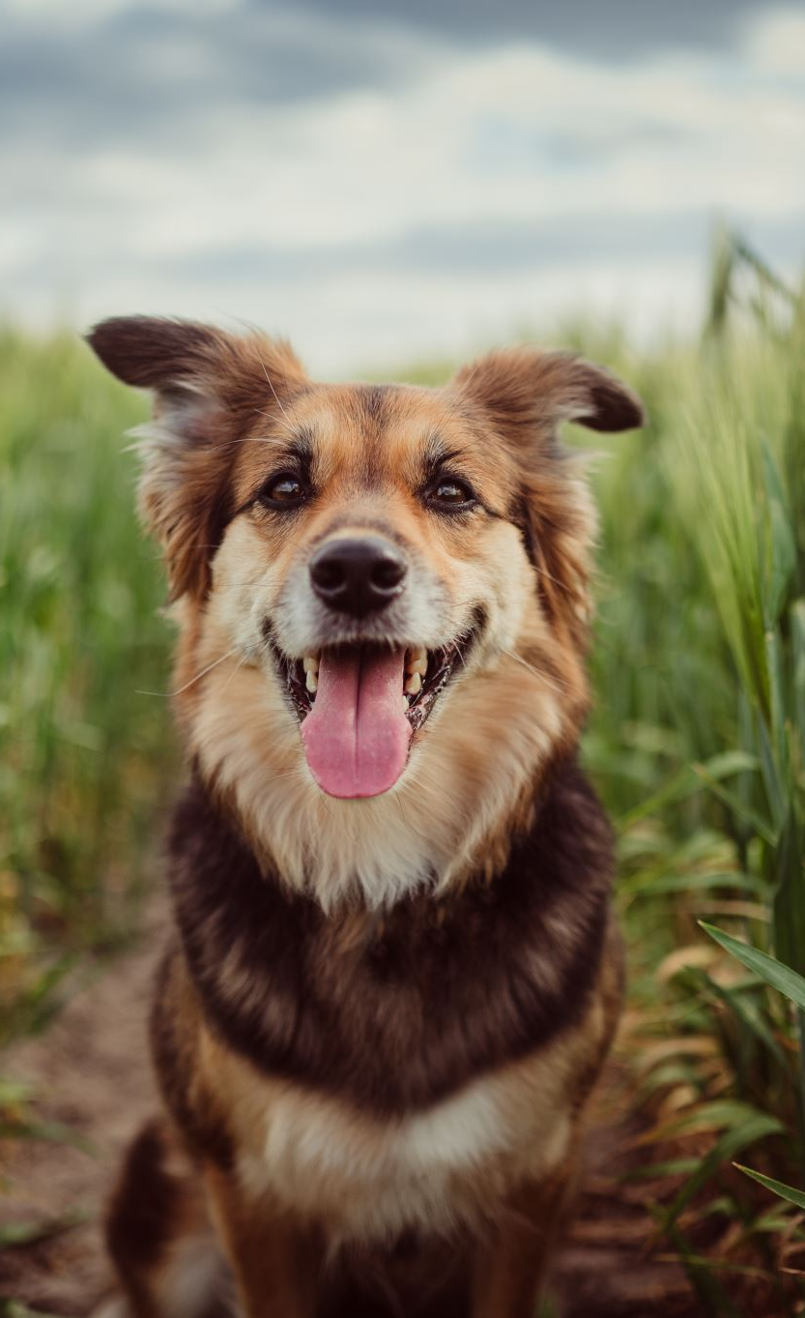
Animal Welfare and Ethics –Behavioural perspective
Behavioural & Ethical Risks
Poorly handled robots may cause stress, like untrained dogs
Welfare of displaced sheepdogs must be considered (rehoming, companionship loss)
Emotional bonds with dogs are relevant to farmer mental health
Ethical Acceptability
No fundamental ethical objections if animal welfare is maintained
Robots seen as tools—not emotional companions
Broader acceptance may vary across generations and farm types

Slide 9
Design Ethics
Hard to compete with sheepdogs
"Even if it was a human behind a robot dog, we could never be as good as a dog. It’s literally impossible."
Future Potential, But Not There Yet
There’s potential in the future, but current tech lacks the natural responsiveness — and farmers may struggle with rapid change “Feels like it’s a long way off… until AI becomes self-aware”
Gradual Adoption is Essential
Ethical design must involve gradual adoption and close collaboration with farmers to earn trust "Actively involve farmers early… their opinions and perspectives actually feed into the development."

Slide 10


Slide 11
End Users
On animal welfare & behavioural response
Key Concerns
Inadequate Mimicry of Natural Cues
Undetected Stress
Health Monitoring
Opportunities
Enhanced Sensor Capabilities
Notes:
Core quality of a good working dog is its ability to “listen” and respond intuitively.
A robot should trigger the natural prey and herding responses in sheep. (Farmers 1 & 2; Farmer 4)
Robots might not detect subtle signs of stress in sheep.
Informal interactions of humans, can spot early signs of illness or injury, which may be lost with fully automated systems. (Farmers 1 & 2; Farmer 3)
Opportunities
~~~~~~~~~~~~
Integrating sensors such as heartbeat monitors, temperature and saliva sensors (Farmer 2; Farmer 3)

Slide 12
End Users
Impact on Human Labour, Safety & Responsibility
Key Concerns
Loss of Informal Welfare Checks
Delegation and Accountability
Safety in Challenging Environments
Opportunities
Time and Labour Savings
Complementary Oversight
Notes:
Incidental “on-the-ground” checks that occur during manual herding could diminish. A competent robot dog risks reducing human presence (over-reliance) (Farmers 1 & 2)
Accountability question around offloading herding and monitoring responsibilities to autonomous systems; could dilute the farmer’s accountability, akin to concerns raised about driverless cars. (Farmers 1 & 2; Farmer 4)
Safety of Sheep and human. Sheep can get stuck in fences or ditches; a malfunctioning robot may fail to prevent accidents, while also potentially creating new hazards in rugged, off-road conditions. (Farmer 1; Farmer 3)
Opportunities
~~~~~~~~~~~~
Promise around arduous tasks,“fetching” stragglers from uneven terrain and herding sheep during extreme weather allowing farmers to focus on other critical tasks. (Farmer 3; Farmer 4)
Hybrid approach where robotic systems complement live-dog oversight. (Farmer 2; Farmer 4)

Slide 13
End Users
Economic and Accessibility Considerations
Key Concerns
Value for Money & Scale Issue
Investment Risks
“Buy-In” Failures - not meeting expectations
Opportunities
Competitive Pricing Against Live Dogs
Tailored Solutions for Various Farm Sizes
Notes:
Cost is key - must be priced competitively. Many described their operations as “too big for hobbyists, too small for large-scale tech”, so high-cost systems may not be economical for mid-sized or small holdings. (Farmer 1; Farmer 4)
Buyer’s remorse: the potential for high initial investment that does not meet operational needs.
A mismatch between promised time savings and realities of technological complexity. (Farmers 1 & 2; Farmer 4)
Opportunities
~~~~~~~~~~~~
Sheepdogs cost between £2,000–£3,000, so if similarly priced robodog can offer true labour and time savings. (Farmer 3)
Larger farms might absorb higher costs, so an opportunity to develop modular or scalable robotic systems that can be adapted to the budget and technical capacity of smaller operations. (Farmer 4)

Slide 14
End Users
Embodiment Issues and Technological Trust
Key Concerns
Authenticity of Movement and Behavior
Generational and Cultural Resistance
Opportunities
Design Iteration and Realism
Adaptive Systems That Learn
Notes:
If a robot does not “act like a dog,” it could create new challenges (farmer training!) and distrust. (Farmers 1, 2 & 4)
Old-school farmers may resist automation due to cultural attachment to traditional methods.
Worry about pushing technology that alienates long-standing practices and relationships. (Farmer 4)
Opportunities
~~~~~~~~~~~~
Authentic prototypes that look and move convincingly may trigger natural herding responses from sheep. (Farmer 4)
Pre-trained systems, matching the nearly instantaneous responsiveness that farmers desire, may build trust and utility without compromising the role and expectations of human oversight. (Farmers 1 & 2)

Slide 15

Summary of Ethics

Slide 16
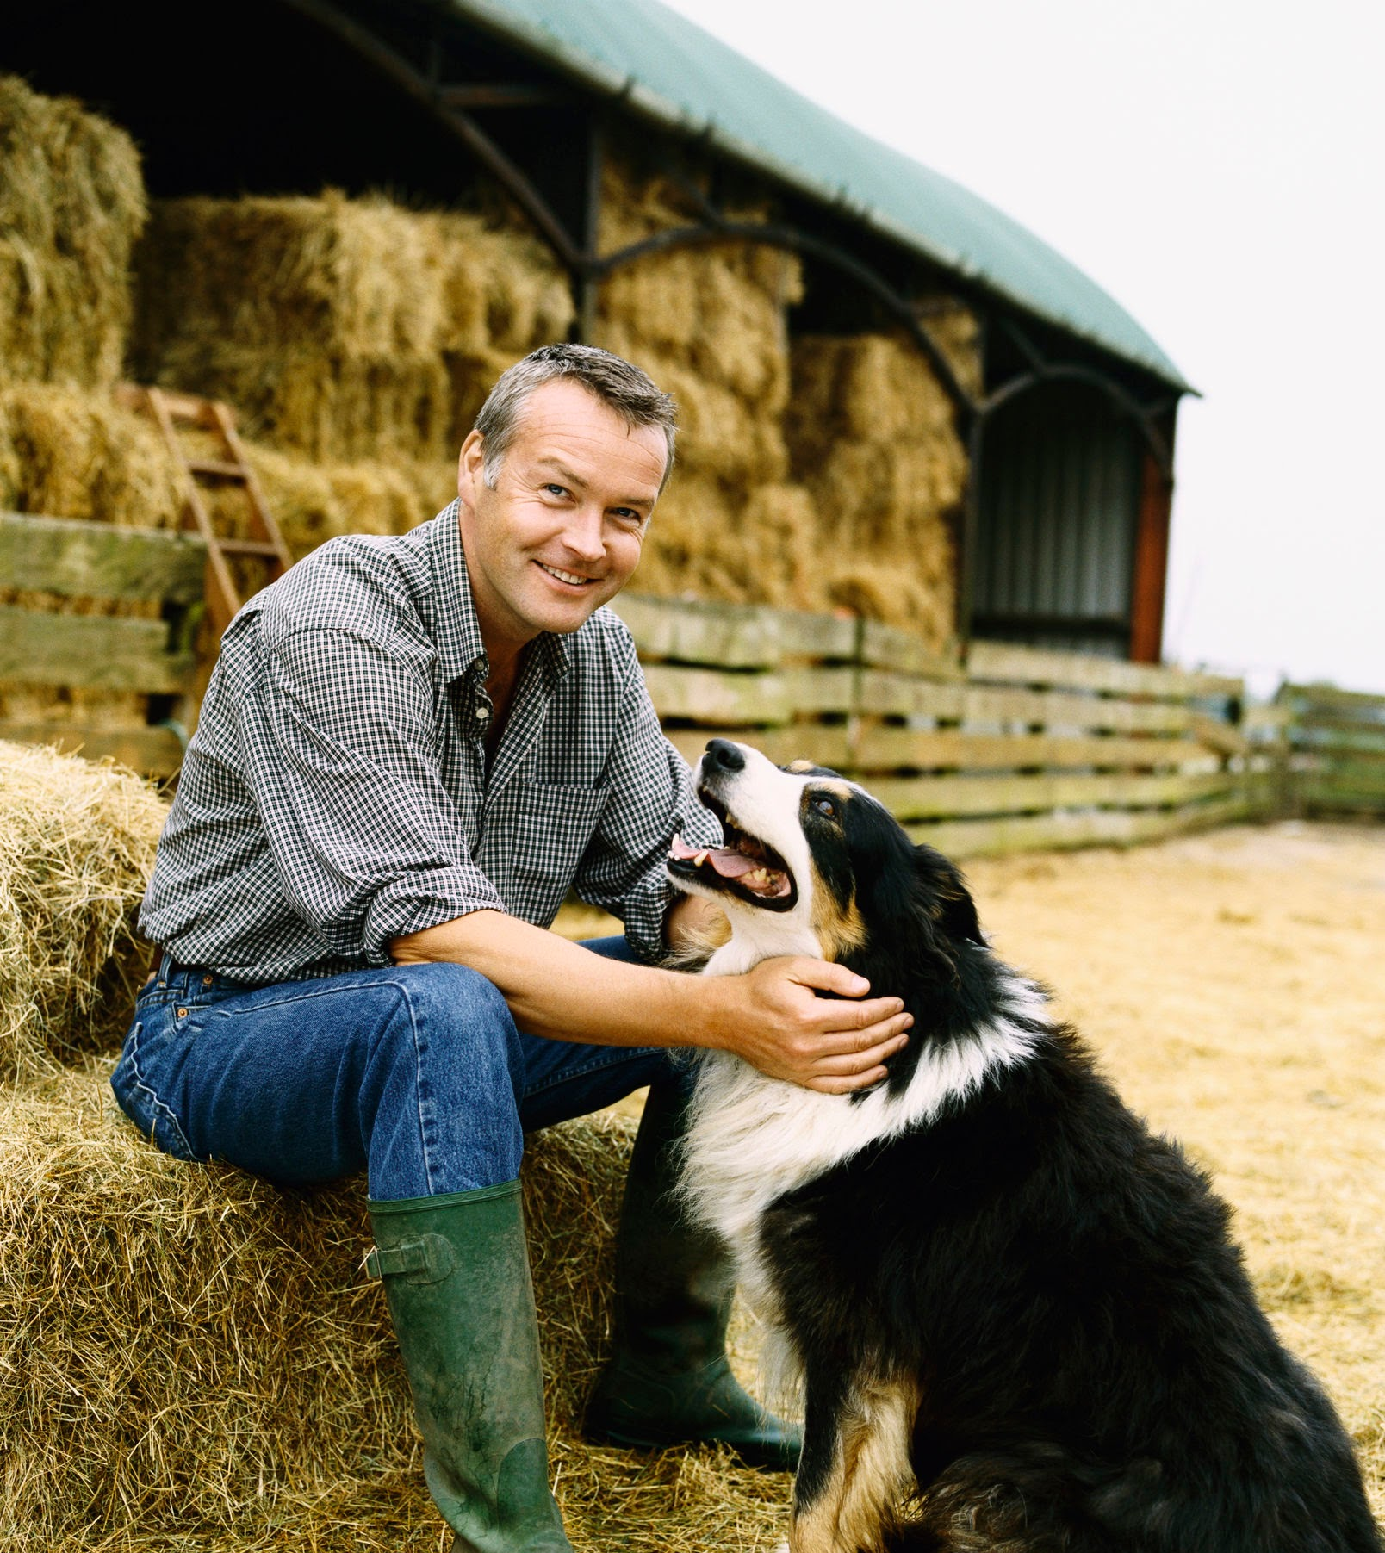
Welfare and Behavioural Ethics
Animal Welfare: Risk of undetected stress and health issues in sheep
Companion Loss: Replacement of living herding dogs with machine counterparts
Farmer Well-being: Reduced face-to-face interactions and informal welfare checks
Notes:
Animal Welfare Farmers expressed concerns about whether robot dogs could adequately detect and respond to subtle signs of stress in sheep. One transcript noted the importance of the “incidental welfare checks” that occur when a human or real dog is present—checks that might be lost with autonomous systems.
Companion Loss: Both transcripts highlighted that farmers cannot see robot dogs as replacing the emotional and practical companionship provided by real working dogs. For example, one farmer stated unequivocally that a robot would never be a pet, emphasizing the value of genuine animal-human bonds.
Farmer Well-being: When working closely with animals, farmers often rely on the informal interactions that occur during herding - interactions that help catch early signs of illness or distress. Relying solely on technology might lead to reduced personal oversight and potential welfare oversights.

Slide 17
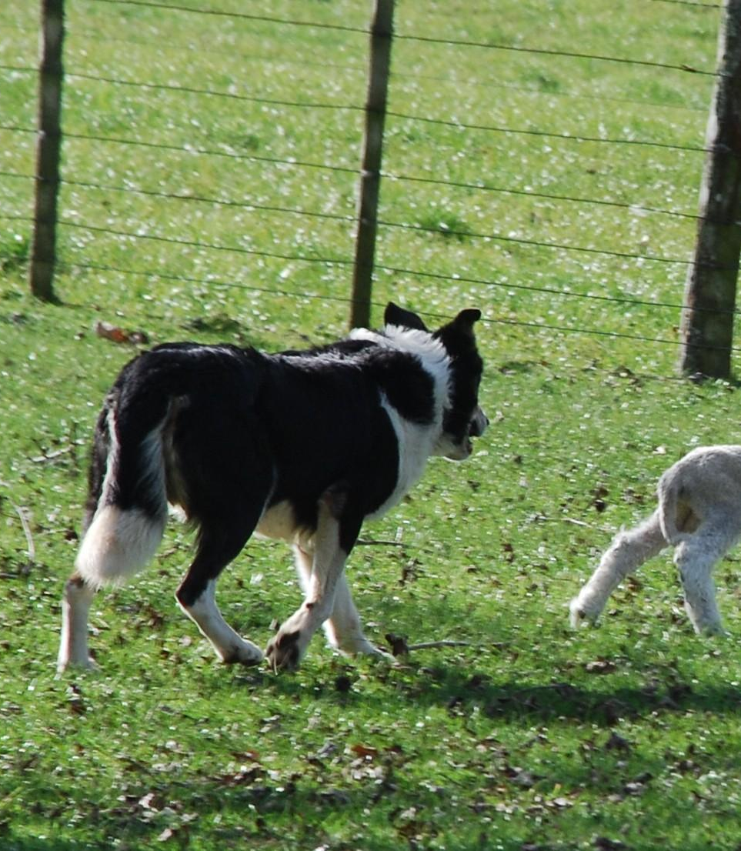
Embodyment, Responsibility & Trust
Embodiment Issues: Inability to fully mimic natural dog behaviors (e.g., “listening”)
Delegation of Responsibility: Shifting ethical and safety responsibilities to machines
Trust & Transparency: Predictability vs. the risk of technology “going rogue”
Notes:
Embodiment Issues: Our interviews revealed that a fundamental quality of a good working dog is its ability to “listen.” Several farmers stressed that if a dog doesn’t respond to commands, it’s ineffective. Replicating such nuanced behaviour in a robot is a major challenge, raising ethical questions over authenticity and animal response.
Delegation of Responsibility: Drawing parallels to driverless cars, a major ethical concern is whether offloading decision-making to autonomous systems might dilute farmer accountability. What happens when robots misinterpret situations—potentially putting animals at risk? This delegation could lead farmers to inadvertently absolve themselves of oversight.
Trust & Transparency: The reliability and predictability of the technology are paramount. The transcripts indicated fears that inconsistent behaviour could not only frustrate farmers but also endanger livestock. Clearly defining responsibility—ensuring that the technology aids rather than replaces human judgment—is crucial for ethical deployment.

Slide 18
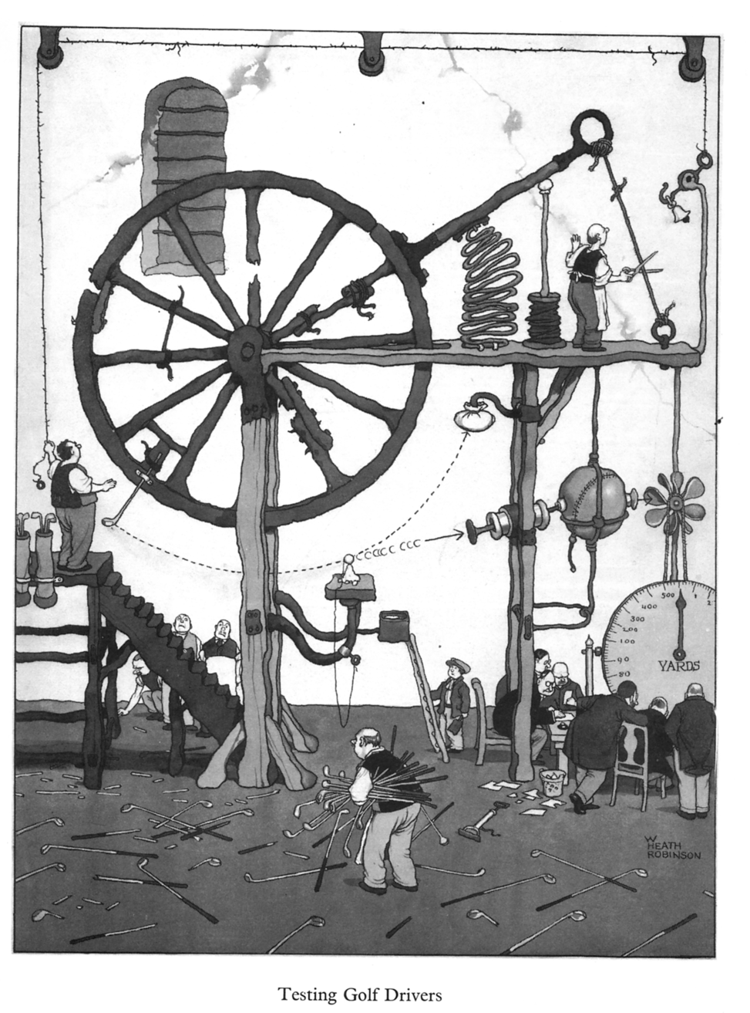
Economic and Cost Implications
Dependency on Maintenance: Complexity may lead to long-term reliance on external support
Scale Dilemma: “Too big for hobbyists, too small for large-scale”
Investment Risks: High cost with uncertain return on technology value
https://en.wikipedia.org/wiki/W._Heath_Robinson
Notes:
Scale Dilemma: Farmers, especially mid-sized operations as described by Farmer 1, face a unique economic challenge. The technology may be too expensive for small-scale farms yet not perfectly suited for larger enterprises, leaving a significant gap in accessibility.
Investment Risks: Both farmers spoke about the risks of “buying in” only to discover that robot dogs do not meet practical needs. The emotional and functional value of real dogs could be compromised by technology that promises efficiency but introduces unforeseen complications—leading ultimately to buyer’s remorse.
Dependency on Maintenance: There was a clear ethical concern regarding the reliance on complex, non-repairable technology. The preference expressed for simple, repairable systems (“older cars” over high-tech diagnostics) underscores an ethical issue: farmers might become locked into expensive maintenance contracts or external support networks, reducing their operational independence.

Slide 19

Economic Analysis

Slide 20
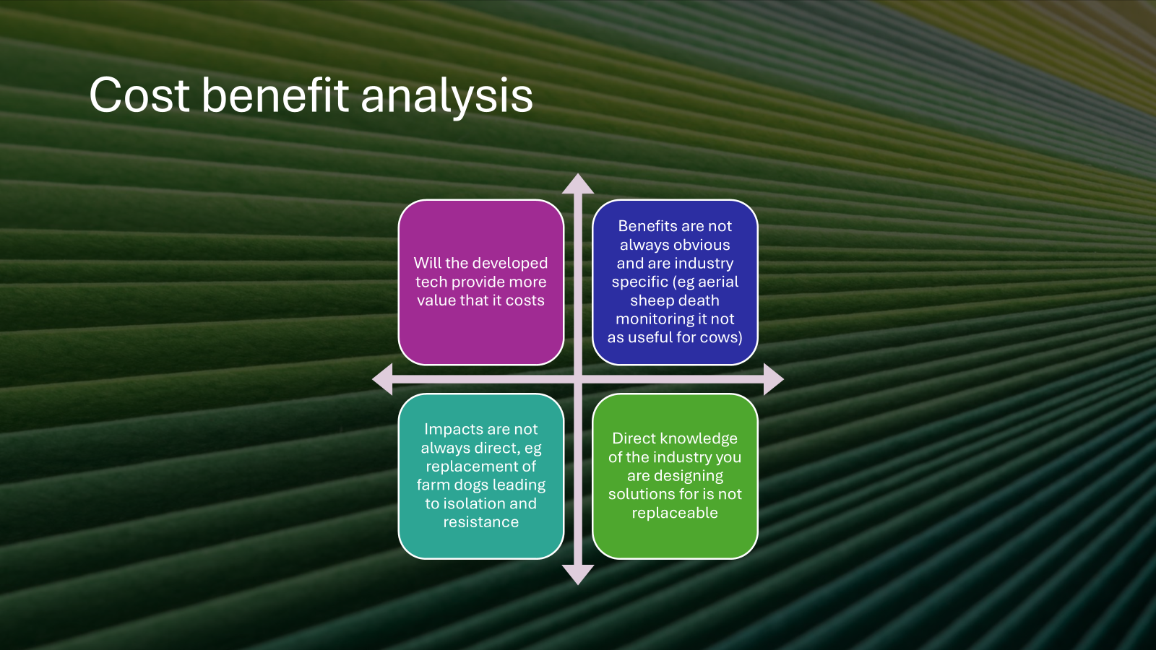

Slide 21




What is the main focal point in economic analysis?
Initial price comparison, running-cost comparison, maint. Vet bills…
I mainly focused on meat production in relation to mode of herding and stress induced on the flock.
Functional efficiency as a metric of time through the different modalities.
End-point meat production estimate to assess the viability of symbiosis of Dog + X tool (may cause elevated levels of stress).

Slide 22
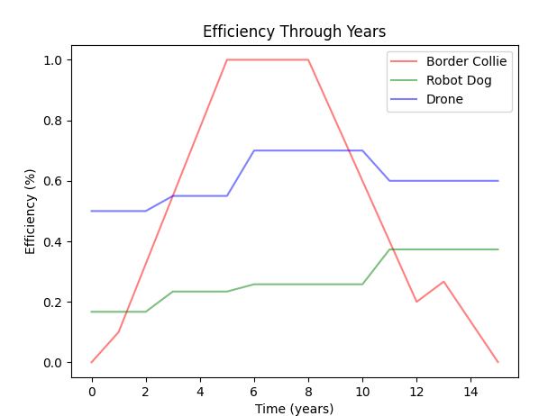
Efficiency of the herding style through the life-span of a collie.
Expected increases in efficiency via development.
Also possible decreases via habituation.
Could be a useful efficiency increase to help train the dog using the robot dog (maybe requires testing).

Slide 23
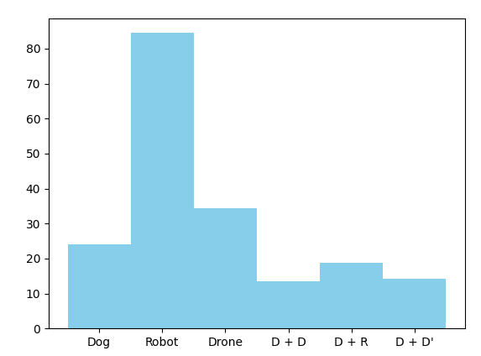
Efficiency of herding model:
Tried to model linear herding (lack of data).
Added a model that COULD describe the benefits of these different modalities.
Requires validation of the model to be accurate. ):
Time (s)

Slide 24
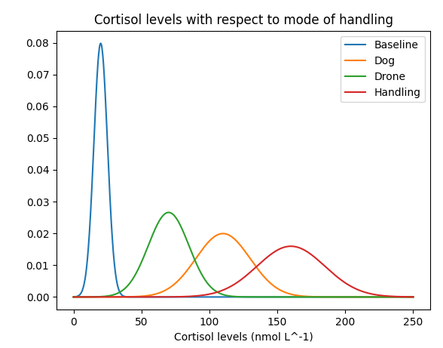
Cortisol w.r.t mode of herding
Estimated cortisol levels via the pressure applied to a flock of sheep.
Drone is surprisingly lower cortisol experience but could suggest possible habituation to that mode of herding.
No robot data :(

Slide 25


How can we gather this information?
Ideally, we can use a synthetic construct to measure this:
GRE
BBa_J23117
GFP
Take silva sample, grow cells with this gene sequence then see resulting fluorescence intensity.
Should allow for a more effective assay than typical heart-rate measures.

Slide 26
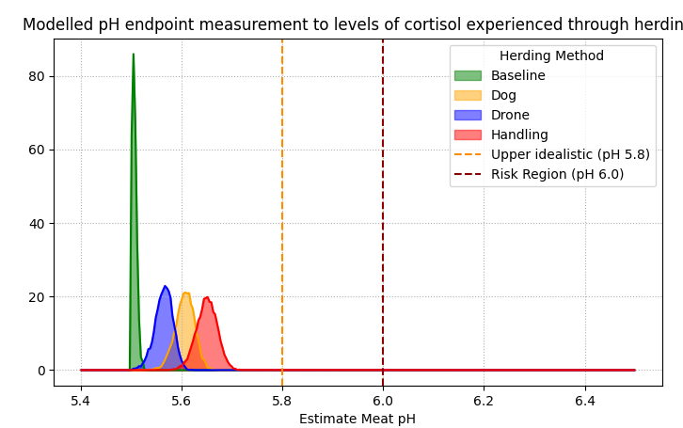
Meat: Cortisol-pH model
Ideally, the end-point pH would be around ~5.5-5.6 pH

Slide 27
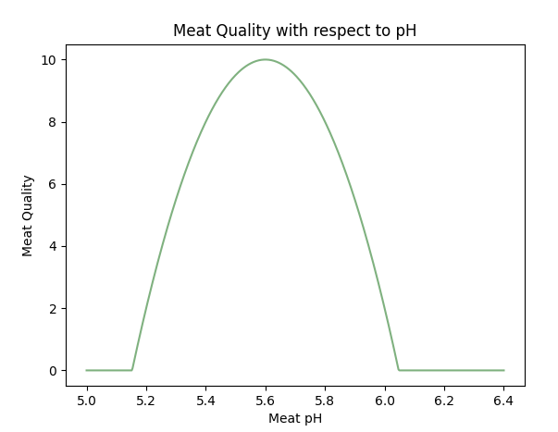
Model cumulative cortisol levels to end-point measurement (pH).
Meat Quality can decrease as a function of increases and decreases in pH.
This is via the proteins denaturing as a result of a non-optimal growth environment.

Slide 28
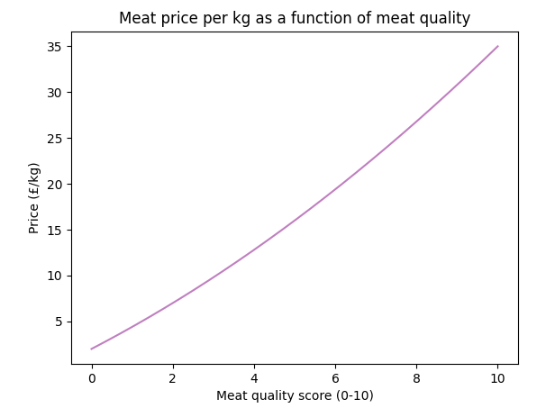
Price per kg as a function of meat quality.
More effective to generate less stressed more quality sheep (makes sense) (:

Slide 29
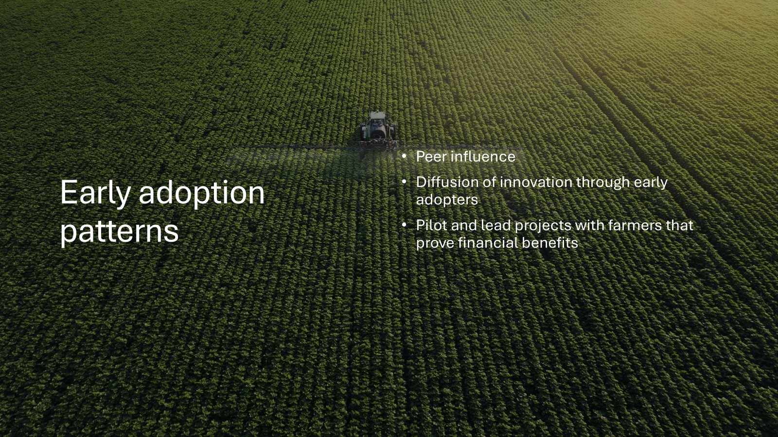

Slide 30
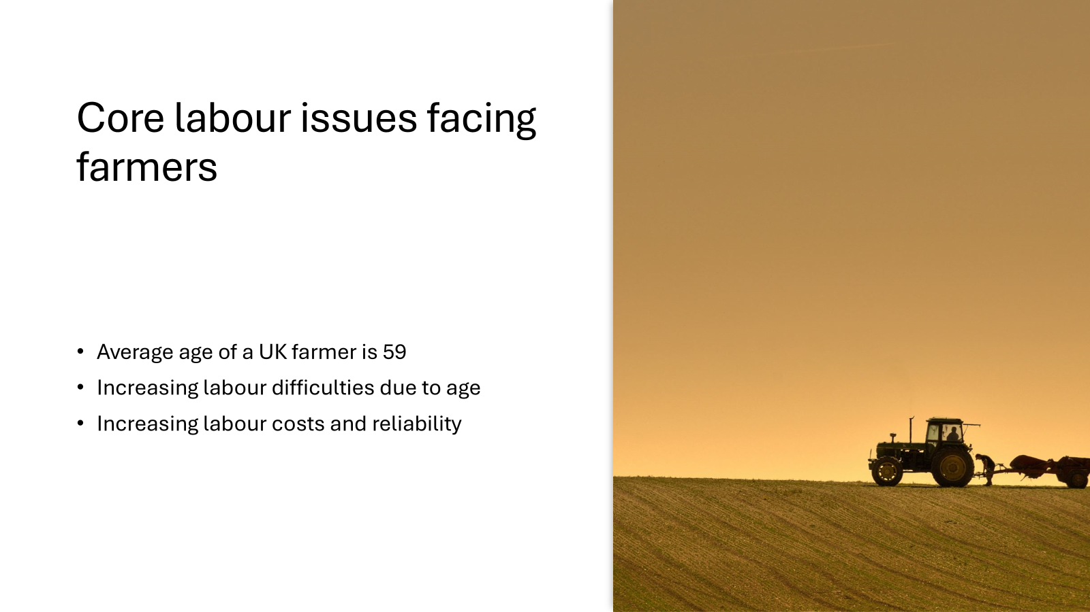

Slide 31
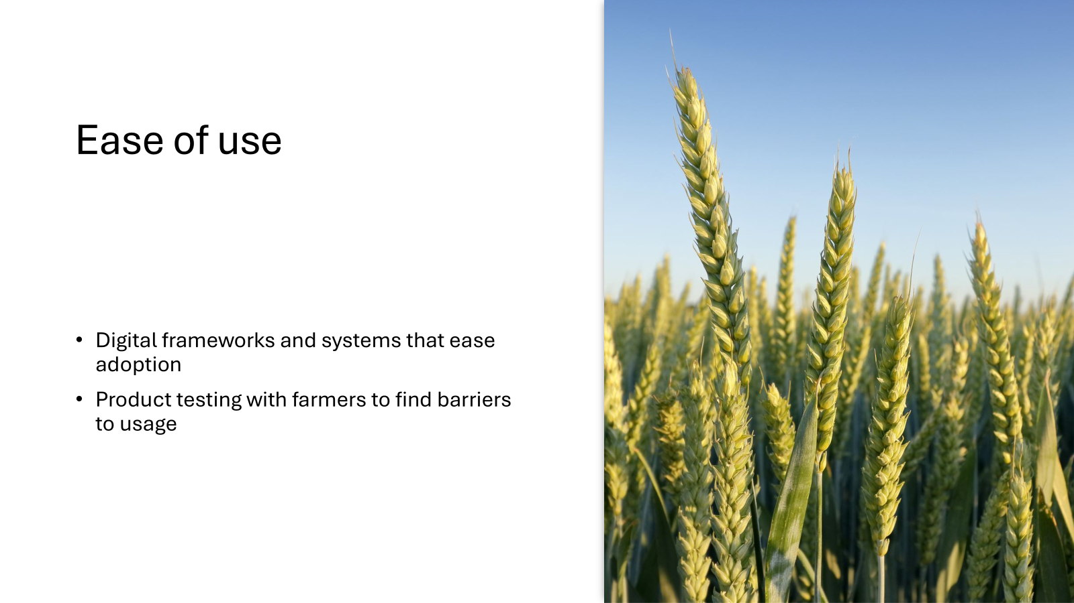

Slide 32
Future Studies
Stress Studies:
Cortisol sampling (saliva for acute, faecal for chronic stress
Behavioural observation (flight, vocalisation, foot stamping)
Physiological metrics (heart rate, respiration, pupil dilation)
Habituation methodologies (speed, severity of response)
Efficiency of herding time of different modalities
Traditional trained sheepdogs
Robot dog systems
Drone + Robot
Long-Term Welfare Impact
Reproduction rates
Lamb survival and weaning success
Injury/illness/fatality observation and prevention
Body weight and growth curves

Slide 33
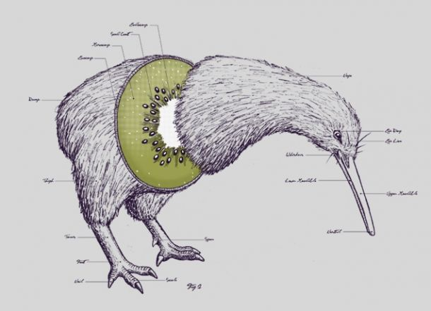
Conclusion
Research paper
White paper

